Slide 1
TRAINING OF GIS EXPERTS IN DEFORESTATION MONITORING
Foster Mensah, fmensah@ug.edu.gh
Centre for Remote Sensing and Geographic Information Sevices (CERSGIS)
Accra, Ghana
September, 2021

Slide 2
Overview : Google Earth Engine

Slide 3
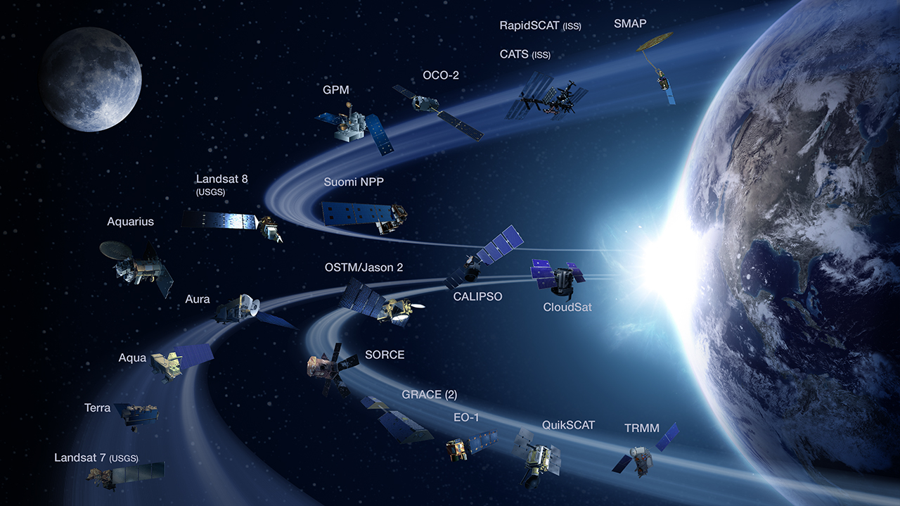

Slide 4

Earth Engine hosts over 50 Petabytes of Earth observation data

Slide 5
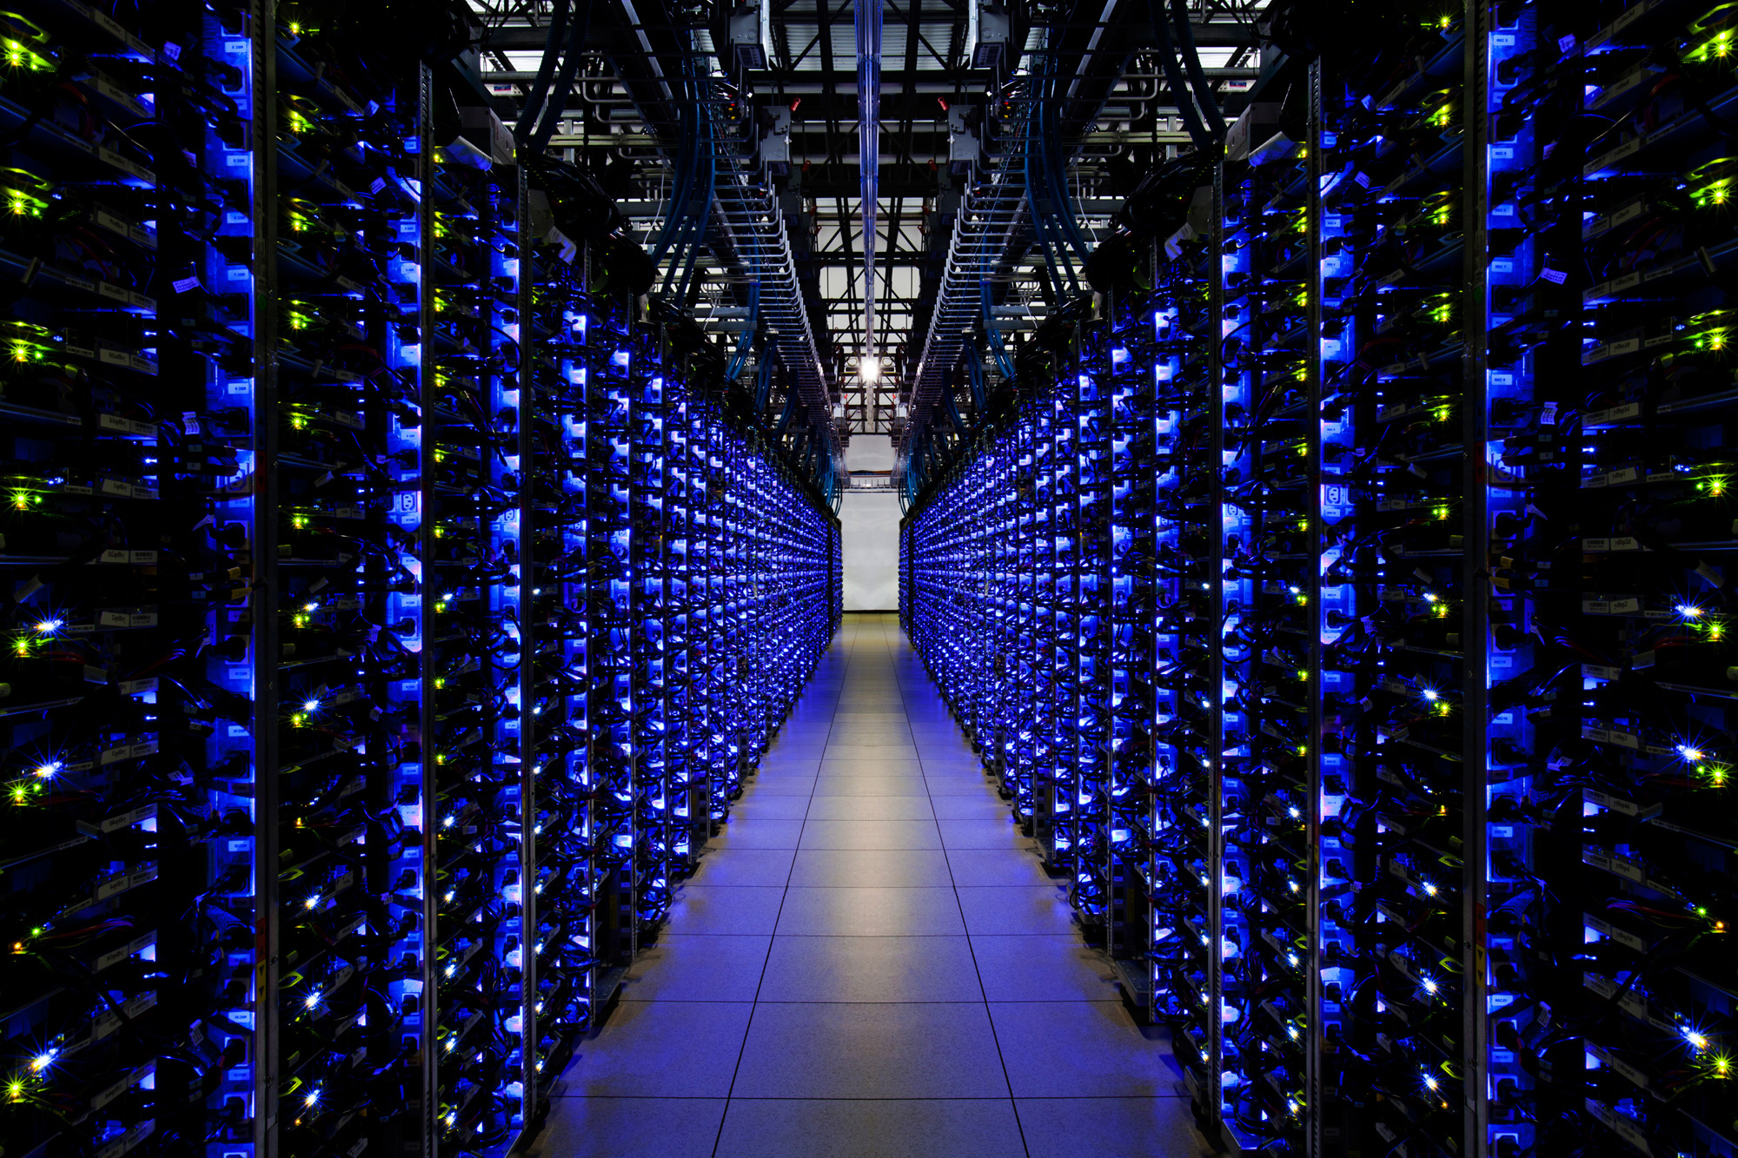
Google computational infrastructure
Notes:
Massive computing power colocated with the data is required.

Slide 6
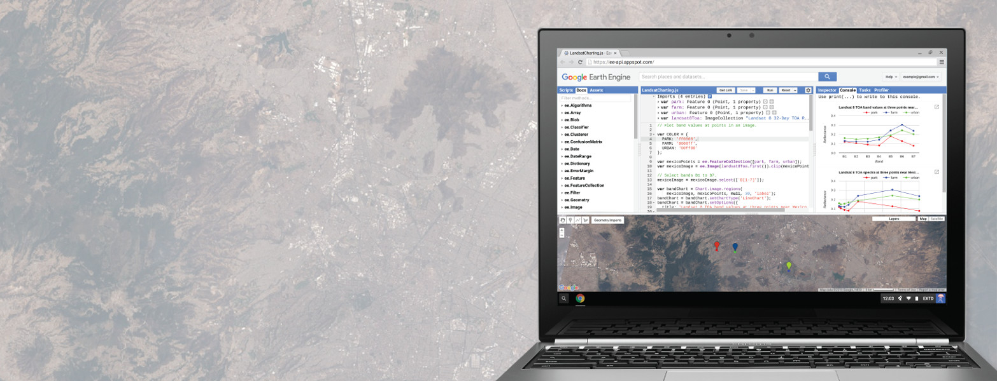
Application Programming Interface (API)*
* JavaScript and Python

Slide 7
Data Catalogue

Slide 8
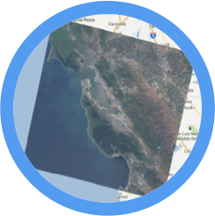


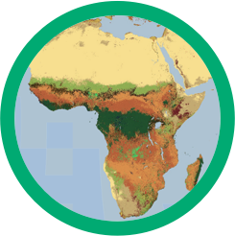

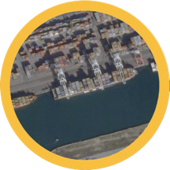
Landsat & Sentinel 1, 2
10-30m, weekly
MODIS
250m daily
Vector Data
WDPA, Tiger
Terrain &
Land Cover
Weather & Climate
NOAA NCEP, OMI, ...
... and upload your own vectors and rasters
> 200 public datasets
> 4000 new images every day
> 5 million images
> 7 petabytes of data

Slide 9
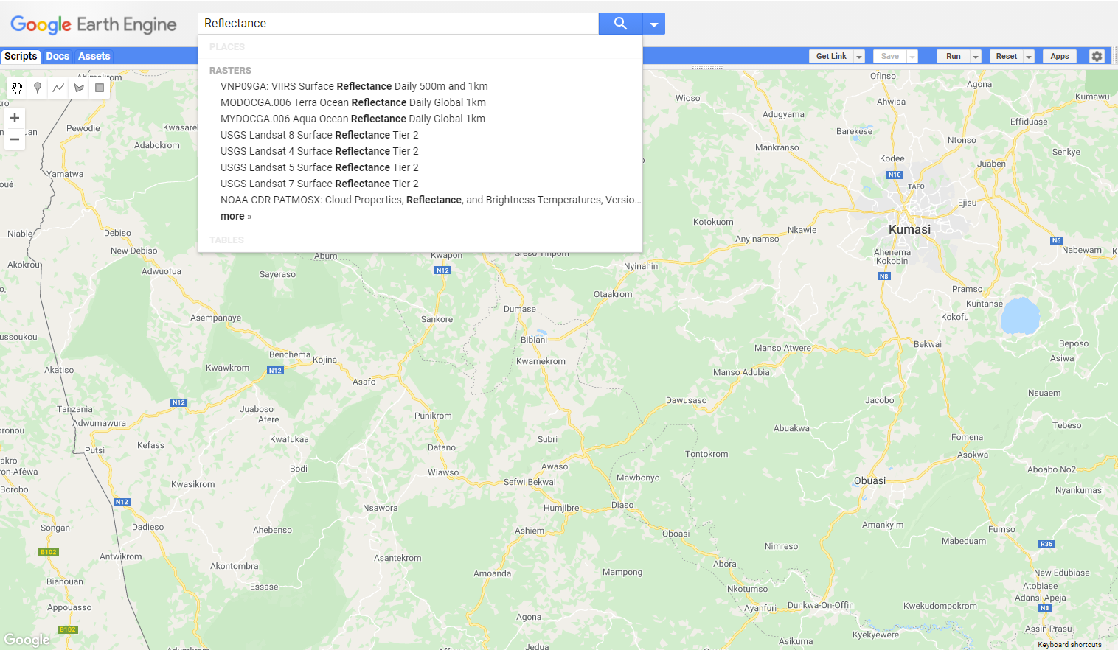
Search

Slide 10
Application Programming Interface

Slide 11
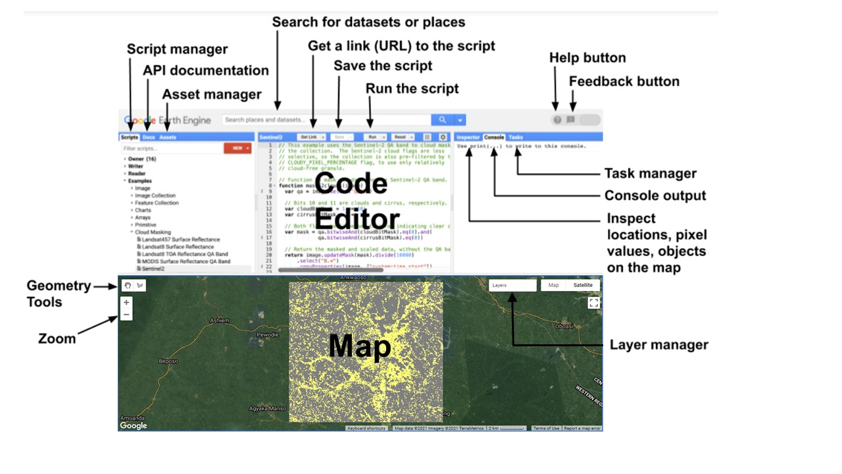

Slide 12
GEE Geospatial Analysis Concepts

Slide 13
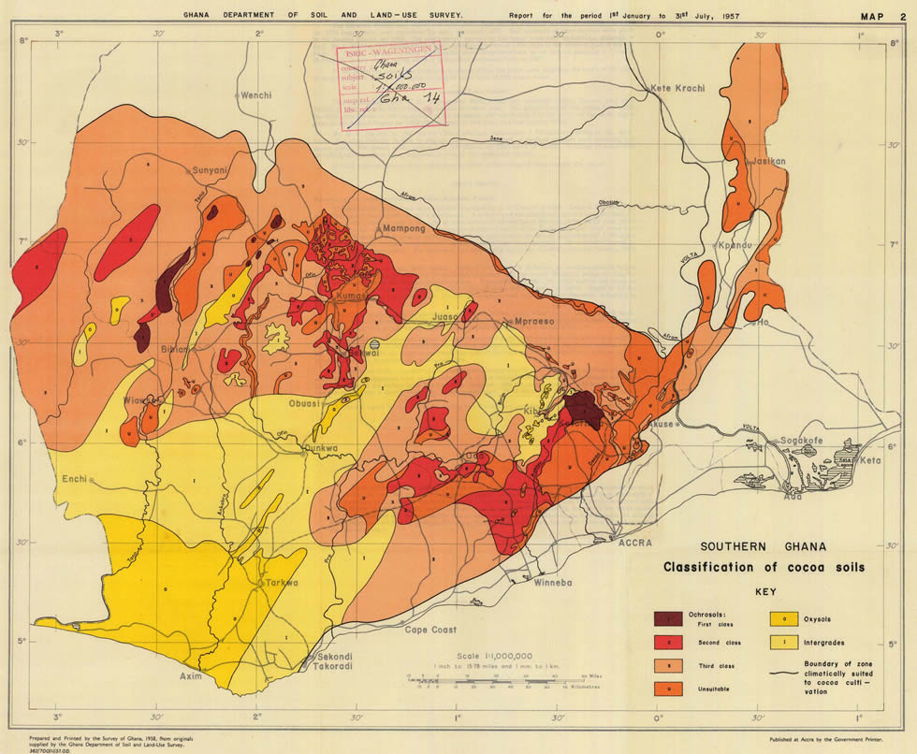
Data Models
Feature
Line / Point / Polygon
List of Properties
Classification of cocoa soils in Ghana

Slide 14
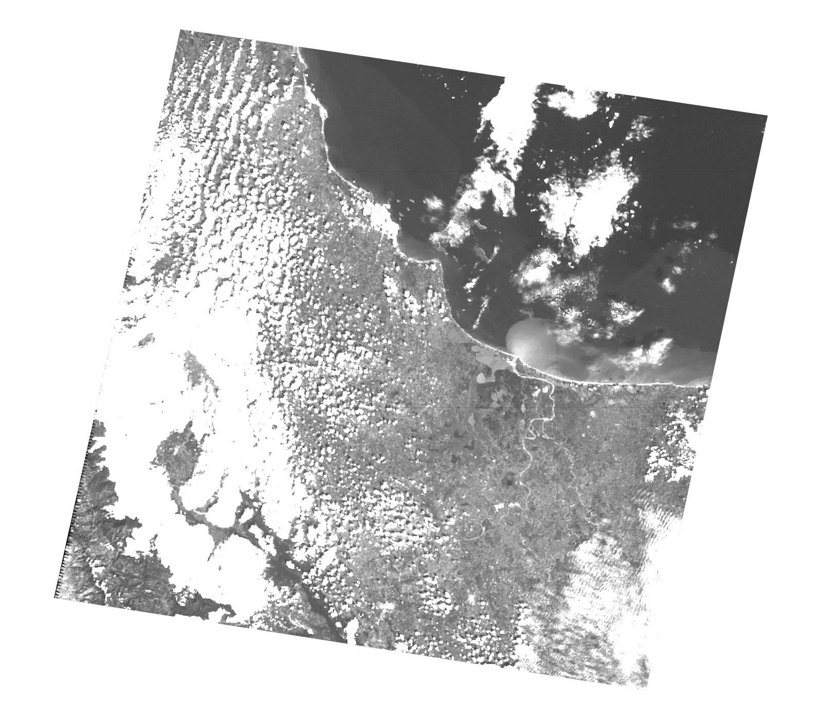
Data Models
Image
Stack of Georeferenced bands
Each band has its own:
Mask, Projection, Resolution
A list of properties, including:
Date, Bounding-box

Slide 15

Data Models
Collection
Bag of Elements
Table of Features
Directory of Images
Filter, Sort, Join, Map, Reduce

Slide 16
Per pixel computations
https://developers.google.com/earth-engine/guides/image_math

Slide 17
Compositing (aggregation over a stack)
Reduction

Slide 18
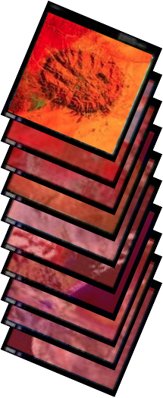
Map
Apply a function to each element of a collection
A "map" (for-each) operation
Examples
Compute area of each feature
Cloud cover of each image
Mosaic for each month

Slide 19
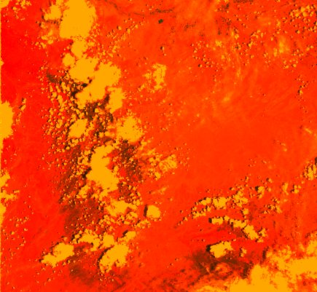
Reduce
Aggregate everything in a collection
"Reduction"
Examples
Summed area over all features
Median-pixel composite
Train a classifier

Slide 20
Reduce Bands
B1
B2
B3
B4
+ B5
103

Slide 21
Reduce Neighbourhood

Slide 22
Reduce Image Collections

Slide 23
Reduce Region
Dictionary
{
B1: 8.3,
B2: 14,
B3: 176,
B4: 1.6,
B5: 7
}
B1
B2
B3
B4
B5

Slide 24
Reduce Regions
FeatureCollection
F1
F3
 | B1 | B2 | B3 | B4 | B5
F1
F2
F3
B1
F2
B2
B3
B4
B5

Slide 25
GEE can be used for:
EO data visualization
Per pixel computations
Machine learning (classification, regression, clustering)
Reductions (in space and/or time)
Segmentation
Neighborhood operations (convolutions)
Time series analysis
Interactive apps
Data import and export

Slide 26
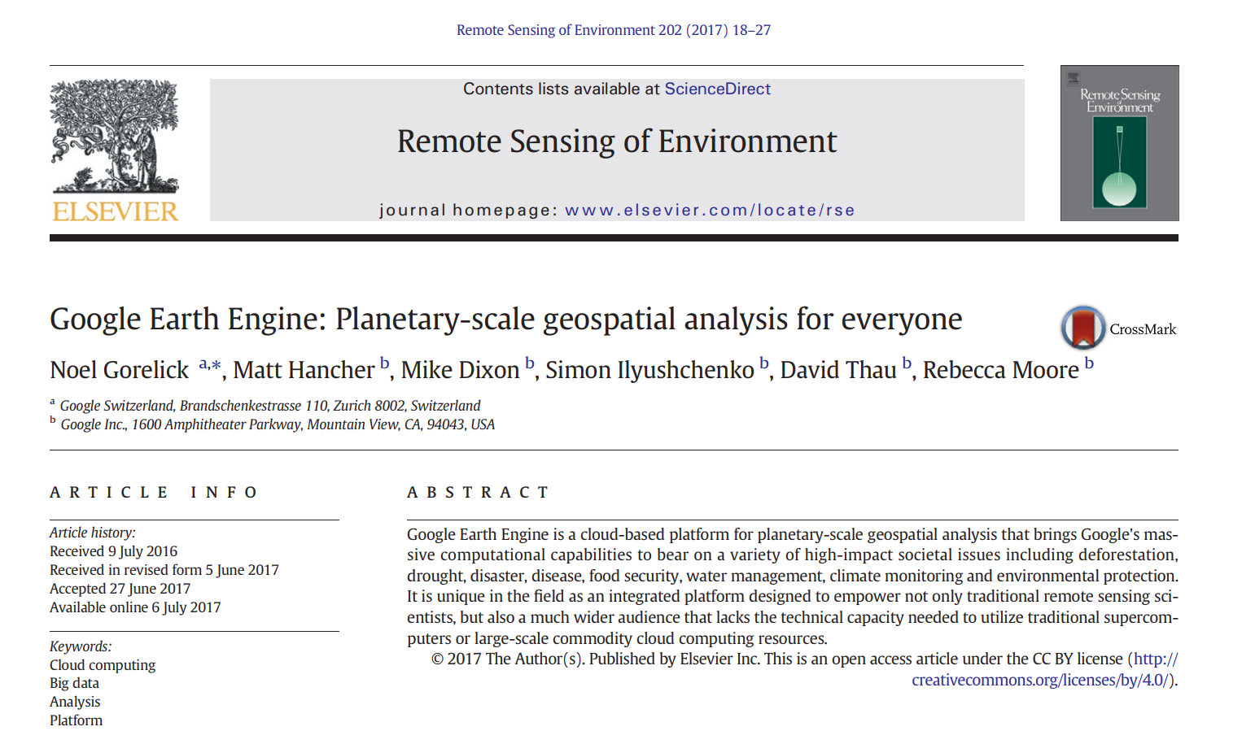
Reference Material
https://www.sciencedirect.com/science/article/pii/S0034425717302900

Slide 27




Thank You
Accra, Ghana
September, 2021
Notes:
It's free for non-commercial use!

